Slide 1

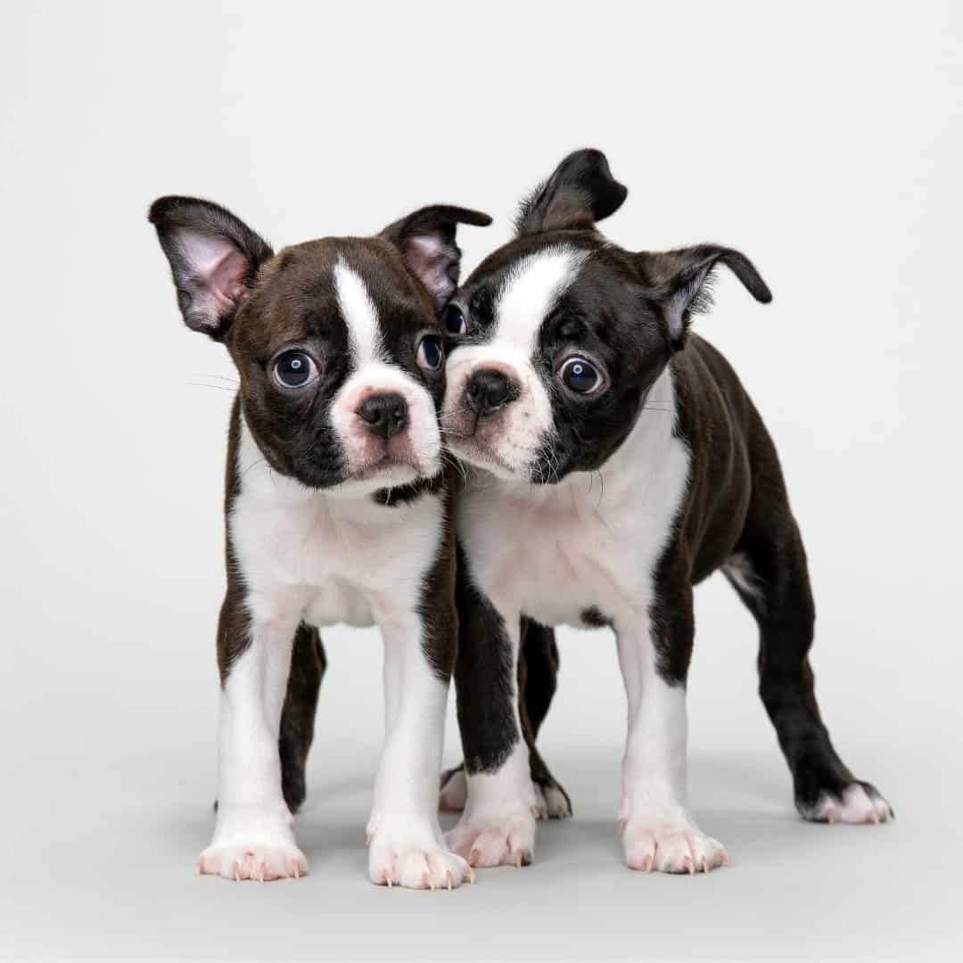

Capstone Project Phase A Project No. 24-1-R-15 Research on Dog - Human Communication Using Eye Tracker Technology
Supervisors:
Dr. Julia Sheidin
Dr. Samah Idrees-Ghazawi
Student:
Sara Asaad

Slide 2

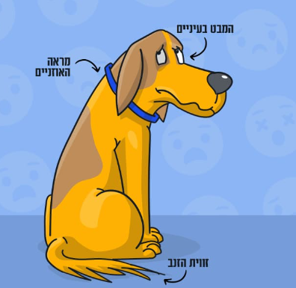
Research Questions
Does focusing on specific parts of the dog's face or body may aid in understanding its emotions?
Which parts of the dog's body or face (normocephalic or brachycephalic dog) provide more information for recognizing emotions?
How can eye tracking technology contribute to a better understanding of dogs and strengthen the connection between humans and dogs?

Slide 3

Motivation
Relationship between humans and dogs.
Importance of understanding dogs' emotions.
Challenges in understanding dog behavior and facial expressions.

Slide 4

Previous Work
Connecting to the study of the Czechs with Prof. Anna Zamansky.
Research subject - human perception of visual communication in brachycephalic vs. normocephalic dogs.
Humans perceived flat-faced dogs as "happy/positive" despite context, relying more on body language.
Our research is a collaboration between Braude College, the University of Haifa, and the University of Czech Life Sciences in Prague.

Slide 5
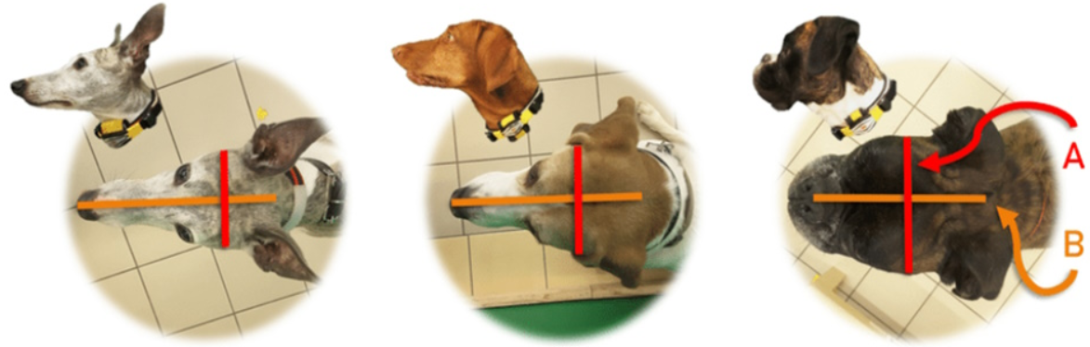
Brachycephalic vs. Normocephalic
Brachycephalia means ‘shortened head’ syndrome.
Brachycephalic dogs will also appear with short noses.
This syndrome refers to a particular set of airway abnormalities.

Slide 6

Dog’s Facial Expressions
calm sad surprised happy laughing
Previous studies:
Indicate the ability of people to recognize the emotional facial expressions of dogs, but not perfectly.
There are differences between the participants.
Some studies struggle to comprehend their visual cues, particularly in dogs with short faces.

Slide 7
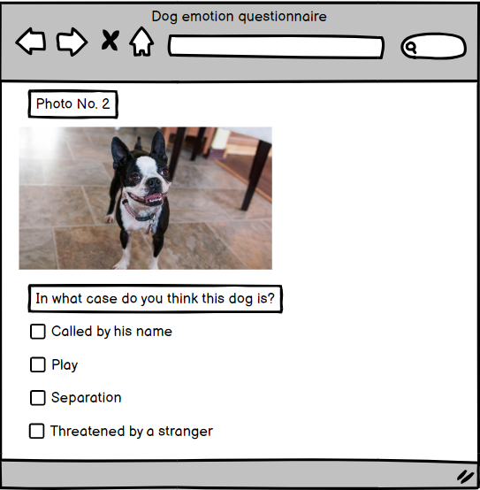
Research Methodology
They did an online experiment.
They provided the participants with videos and photos of brachycephalic and normocephalic dogs in various contexts.

Slide 8

Dataset
Has two groups of dogs: brachycephalic and normocephalic.
Covers 23 different behaviors across four distinct scenarios.
Will contain 5-10 second videos and various images of dog faces in these situations:
Called the dog by his name.
Play.
Separation.
Threatened by a stranger.

Slide 9
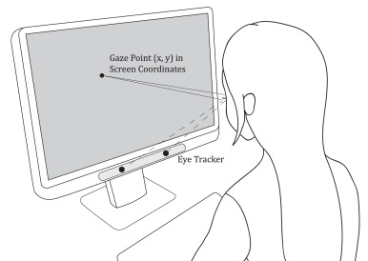
Novelty: Eye Tracking Technology
It is a technology that converts eye movements into a data stream that contains information such as pupil position, the gaze vector for each eye, and the gaze point.

Slide 10
Eye-Tracking Studies
Most of the studies focused on identifying emotional expressions in humans.
Studies analyze eye movements and some areas to understand differences in behavior between groups.
Studies on eye tracking technology's in detecting animal emotions, particularly in dogs, are limited.
Our research can contribute to a better understanding of the relationship between humans and dogs.

Slide 11

Our Contribution
Uses the eye tracking technology to answer the research questions.

Slide 12





Accuracy and Reliability
Brachycephalic dogs
Challenges
Difficult to decode their emotions
Data Evaluation
Participant feedback, understanding dog emotions
For our results analysis
Research environment
Tobii
Uniform for all participants, controlling external factors
The purchase of Tobii's development license.

Slide 13

Our Hypothesis
More time examining brachycephalic dog pictures.
More time watching brachycephalic dog videos.
Brachycephalic dogs harder to understand.
Eye-tracking more accurate than self-report.

Slide 14

Experimental Parameters
Areas of Interest (AOIs).
Fixations.
Saccades.
Scan paths of eye movements.
Proportion of fixations.
Total Observation Time.

Slide 15

Procedure
Participants: 40 Braude College of Engineering students of varied ages and genders.
Experiments will be conducted in a quiet room.
Participants will be seated in front of a Full HD screen.
A Tobii Pro Spark eye tracker will be used.
Participants will view dog pics/videos and identify the dog's situation.
Eye tracking technology will record eye movements.
Data will be algorithmically analyzed.

Slide 16

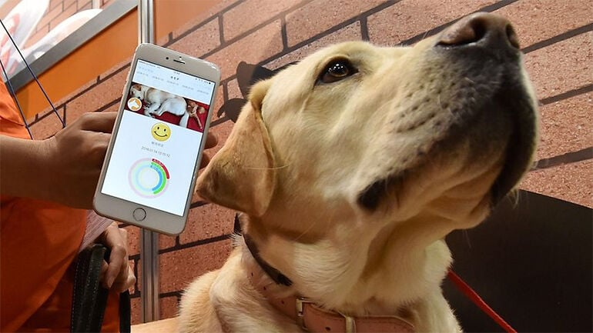
Future Work
Results analysis using different visualization techniques.
Providing guidelines for a future system that will recognize dog's emotions.

Slide 17
References
https://www.bostonterriersociety.com/wp-content/uploads/2023/01/10-1024x1024.jpg
https://cdn.shopify.com/s/files/1/0589/6768/7343/files/Blue_Boston_Terrier_being_held_by_a_person_licking_its_nose_with_a_playful_and_engaging_demeanor..png?v=1706753146
https://media.springernature.com/full/springer-static/image/art%3A10.1038%2Fs41598-021-88702-w/MediaObjects/41598_2021_88702_Fig1_HTML.png
https://img.freepik.com/premium-vector/dog-face-set-pet-head-with-different-emotion-line-icon-canine-facial-expression_352905-1164.jpg
Liu, W., Trapp, A. C., & Djamasbi, S. (2021). Outlier-Aware, density-Based gaze fixation identification. Omega, 102, 102298.‏
https://chayuta.com/assets/uploads/2023/09/Artboard-192-copy.jpg
https://theonlinedogtrainer.com/wp-content/uploads/2023/07/image_4cfb3280e0846a7e9b3f6d0913b04668_2000.png
https://mb.cision.com/Public/2874/3204374/ad9885d61ba4d121_800x800ar.png
https://ih1.redbubble.net/image.5485500524.2106/fposter,small,wall_texture,square_product,600x600.jpg
https://m.media-amazon.com/images/S/aplus-seller-content-images-us-east-1/A1PA6795UKMFR9/A3DHBFJRY43R0C/91e35ec8-f65a-42f4-90b5-87ea0aed83e5._CR0,0,600,180_PT0_SX600__.jpg
https://t4.ftcdn.net/jpg/02/24/25/57/360_F_224255743_1vtOeOxGUjnO95GAB7KvKXmjWt36IPr9.jpg
https://bloximages.newyork1.vip.townnews.com/petproductnews.com/content/tncms/assets/v3/editorial/d/01/d01c3837-b9d2-5c86-9dfa-58d12b875f8b/5f10b5d756a19.image.jpg
Eretová, P., Liu, Q., Přibylová, L., Chaloupková, H., Bakos, V., Lenkei, R., & Pongrácz, P. (2024). Can my human read my flat face? The curious case of understanding the contextual cues of extremely brachycephalic dogs. Applied Animal Behaviour Science, 270, 106134.‏
Bloom, T., & Friedman, H. (2013). Classifying dogs’(Canis familiaris) facial expressions from photographs. Behavioural processes, 96, 1-10.‏
Correia-Caeiro, C., Guo, K., & Mills, D. S. (2020). Perception of dynamic facial expressions of emotion between dogs and humans. Animal cognition, 23(3), 465-476.‏
Guo, K., & Shaw, H. (2015). Face in profile view reduces perceived facial expression intensity: an eye-tracking study. Acta psychologica, 155, 19-28.
Sæther, L., Van Belle, W., Laeng, B., Brennen, T., & Øvervoll, M. (2009). Anchoring gaze when categorizing faces’ sex: evidence from eye-tracking data. Vision research, 49(23), 2870-2880.

Slide 18


THANKS FOR YOUR LISTENING
Now I am ready to answer your questions.

Slide 19
Expected Achievement
Eye-tracking experiments use heatmaps as output to visualize participants' focus.
Eye-tracking technology provides detailed insights into participant eye activity, enhancing investigation efficiency and accuracy.

Slide 20

Research Process
Domain learning.
Choosing a research focus topic.
Review of the Literature.
Define the research methodology.

Slide 21
Our solution
Research in collaboration with Prof. Anna Zamansky, University of Haifa.
Reproduce the study of the Czechs: Petra Eretová, Quanxiao Liu, Lucie Přibylová, Helena Chaloupková, Viktória Bakos, Rita Lenkei, Péter Pongrácz (2024).

Slide 22

Results
Heat maps visualize participant focus by eye-tracking.
Heat maps provide a visual summary of gaze patterns.
Eye-tracking captures detailed gaze behavior during stimulus viewing.
Eye-tracking surpasses traditional methods in efficiency and precision.
Eye-tracking + heat maps = visual attention insights.

